Slide 1
C++ Review
PRANAY NETHA, GUDA

Slide 2

1.Arrays
Array: An ordered collection of elements of the same type, stored in contiguous memory locations, and accessed using an index or a key
In C++, there are multiple ways to declare arrays. Two common ways include the traditional array declaration and the std::array from the C++ Standard Template Library (STL).

Slide 3
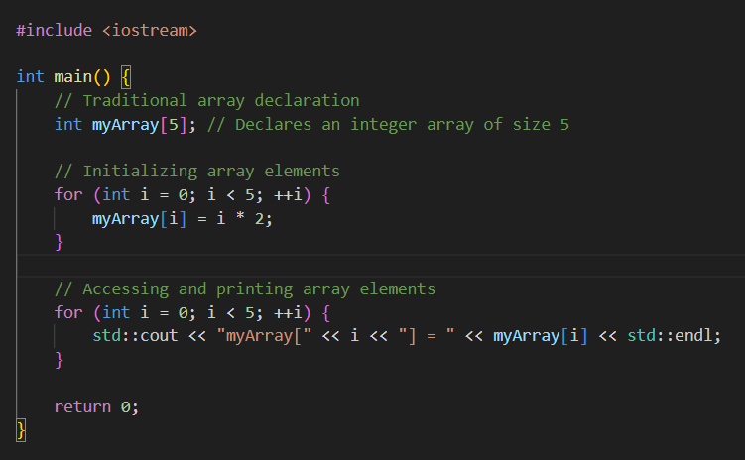
Traditional Arrays
An array is a collection of elements of the same data type.
Elements are stored in contiguous memory locations.
Accessed using an index starting from 0.
Size is fixed and declared at compile time.
No built-in bounds checking.

Slide 4
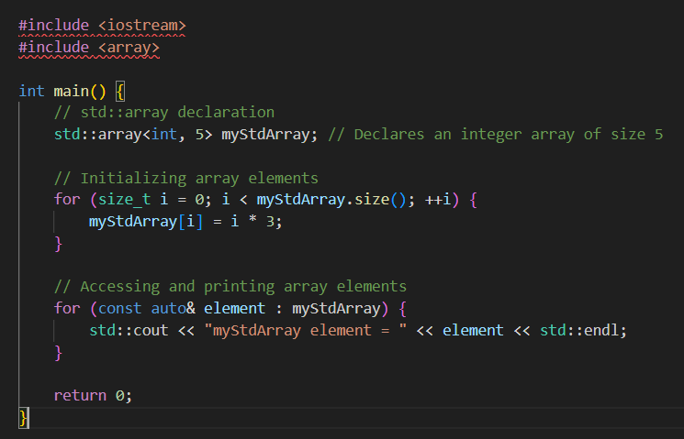
std::array
Introduced in C++11, part of the Standard Template Library (STL).
Similar to C arrays but with additional features.
Size is fixed at compile time.
Provides bounds checking with at() method.
Supports iterators, making it compatible with STL algorithms.
Offers convenient member functions like size() and empty()

Slide 5

2.Pointers
Definition and Declaration:
Definition: A pointer is a variable that stores the memory address of another variable.
Declaration: Pointers are declared using the asterisk (*) symbol.

Slide 6
Address-of Operator (&)
The address-of operator (&) is used to get the memory address of a variable
Dereference Operator (*):
The dereference operator (*) is used to access the value stored at the memory address pointed to by a pointer.

Slide 7


Null Pointers:
Pointers can be assigned a special value nullptr to indicate that they are not pointing to any valid memory location.
Arrays and Pointers:
Arrays and pointers are closely related in C++. The name of an array can be used as a pointer to its first element.

Slide 8
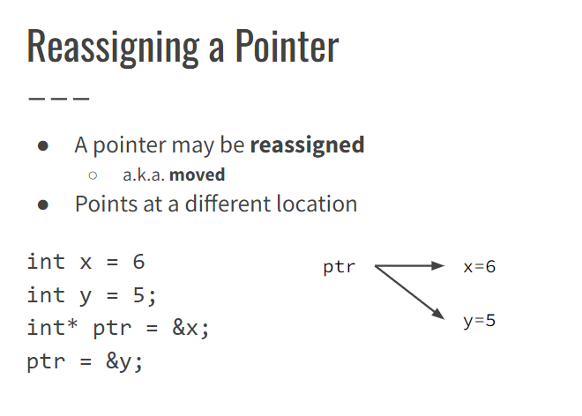

Slide 9
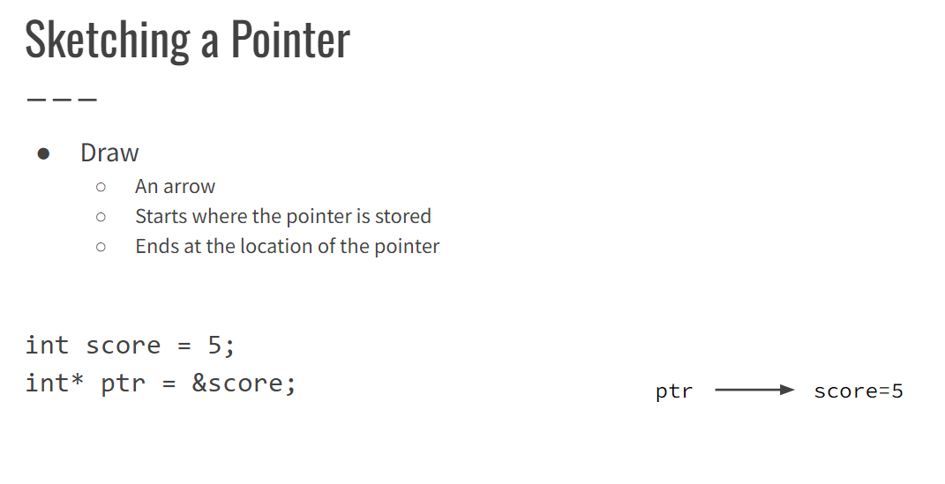

Slide 10
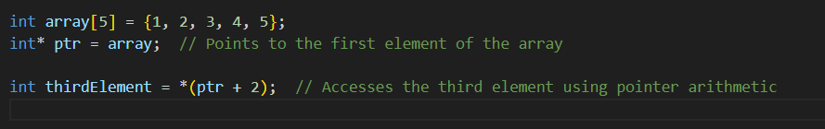
Pointer Arithmetic:
Pointers can be incremented or decremented to navigate through memory.

Slide 11
Invalid Pointer
Invalid pointer: does not point to valid object
Uninitialized pointer string* p1;
Null pointer double* p2 = nullptr;
Dangling pointer: location of deleted object char* p3 = new char; delete p3; // p3 is now dangling
Dereferencing an invalid pointer is a logic error
Don’t: *p1, *p2, or *p3
Usually segmentation fault

Slide 12
Dynamic Memory in C++:
Dynamic Size Allocation:
Dynamic memory allows you to allocate memory at runtime, enabling the creation of data structures with sizes determined during program execution.
Avoiding Wastage:
In static memory allocation, memory is reserved at compile-time, potentially leading to wastage of memory if the actual usage is less than the reserved space.

Slide 13
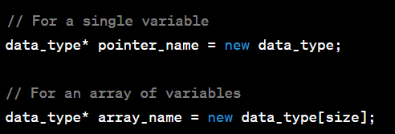
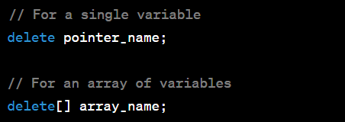
Syntax

Slide 14
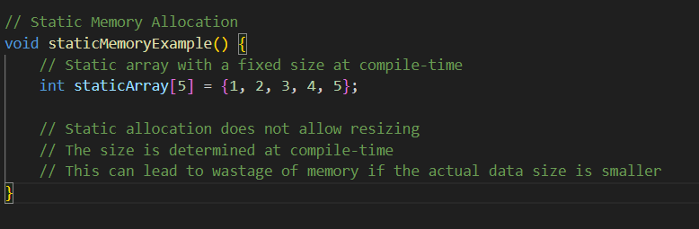
Static Memory

Slide 15
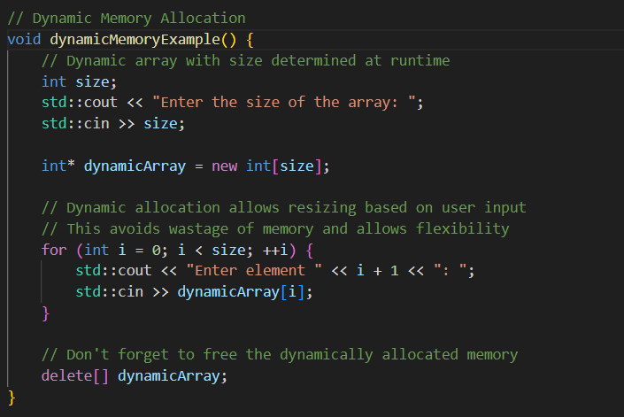
Dynamic Memory

Slide 16
Review: Class Data Members, Constructor, Destructor
Class: object-oriented data type
Class member: thing inside a class
Data member: class member that is a variable
Member function: class member that is a function
Constructor: special member function, initializes data members
Destructor: special member function, destroys data members

Slide 17
Example: Date
class Date { public: Date(int year, int month, int day) : year_(year), month_(month), day_(day) {} ~Date() {} int year() const { return year_; } … private: int year_, month_, day_; };

Slide 18
Default Constructor
Default constructor: no-argument constructor
e.g. Date()
Implicit default constructor: used unless you write your own
Calls the default constructor on each data member
OK if every data member would be initialized by its own default constructor
class Name { … private: string first_, last_; };

Slide 19
Default Destructor
Default destructor: used unless you write your own
Calls the destructor of each data member
OK if no data members need to be deleted
Not OK if the constructor allocated dynamic memory with new

Slide 20
Bug Example: Memory Leak
class DynamicDate { public: DynamicDate(int year, int month, int day) { year_ = new int(year); month_ = new int(month); day_ = new int(day); } …
private: int *year_, *month_, *day_; };

Slide 21
Example: Destructor Fixes Memory Leak
class DynamicDate { public: DynamicDate(int year, int month, int day) { year_ = new int(year); month_ = new int(month); day_ = new int(day); } ~DynamicDate() { delete year_; delete month_; delete day_; } …

Slide 22
Recall: Copy Constructor
template <typename T> class Array { public: // breaks const and has a compile error: Array(const Array& other) : size_(other.size_) { // steal other.elements_ elements_ = other.elements_; other.elements_ = nullptr; } …

Slide 23


References
Reference: alternative to a raw * pointer
Syntax for Declaring a References
A reference is declared using the & symbol after the type.
Once a reference is initialized, it cannot be changed to refer to a different variable.

Slide 24

Similarity With Pointers
A reference refers to another object
A pointer points to another object
Uses
○Pass large argument to function without copying-References are used to avoid unnecessary copies of large objects.

Slide 25
Pointers Vs References
void min_max(int& min, int& max,
int x, int y) { if (x < y) { min = x; max = y; } else { min = x; max = y; }
}
…
int a = 5, b = 3, min_ab, max_ab;
min_max(min_ab, max_ab, a, b);
void min_max(int* min, int* max,
int x, int y) { if (x < y) { *min = x; *max = y; } else { *min = x; *max = y; }
}
…
int a = 5, b = 3, min_ab, max_ab;
min_max(&min_ab, &max_ab, a, b);

Slide 26
Reference Semantics
●Goal: safer than raw pointers
●Must be initialized int x, y; int& r1; // compile error int& r2 = x; // OK
●Cannot be initialized to null int& r3 = nullptr; // compile error
●Cannot be reassigned r2 = y; // compile error
●Prevents most bugs from null/invalid pointers

Slide 27
Const Reference
●const (in general): something is constant
Doesn’t change
●const reference: reference that does not allow changes to the referred object
●Usually passed as an argument to a function that has no business changing the argument
●Prevents bugs due to accidental modification

Slide 28
RAII

Slide 29
The Problem: Remembering to delete
Recall: every time we new, we must delete
Easy to forget → memory leaks

Slide 30
Solution: RAII
RAII (https://en.cppreference.com/w/cpp/language/raii)
Resource
Allocation
Is
Initialization
Goal: all resource management is handled automatically by constructors/destructors
new only happens while initializing an object
destructor deletes precisely what the constructor new’d
This discipline rules out memory leaks
(Also applies to other resources)

Slide 31
Ownership
Every object has a defined owner (class or function scope)
Owner is
Only one that may allocate the object with new
Responsible for freeing the object with delete
RAII: a class either owns an object, or borrows it
Own: must new/delete, no one else does
Borrow: only temporarily uses the object thru pointer/reference

Slide 32
C++ Rule of Three
●Recall RAII
○constructor is solely responsible for new
○destructor is solely responsible for delete
●Rule of Three: if a class defines any of these, it must define all three:
○Destructor
○Copy constructor
○Copy assignment operator

Slide 33
Why?
These are the member functions that initialize an object
Obligated to handle new/delete
Recall
Destructor: called to destroy an object ~ needs to delete owned data members
Copy constructor: called to copy an object ~ needs to make a new copy
Copy assignment operator: called to assign = an object ~ needs to make a new copy

Slide 34
Example: MaybeInt
class MaybeInt: either owns
One integer in dynamic memory; or
Nothing
Example to illustrate Rule of Three
Single responsibility principle: better to use std::optional instead

Slide 35
Bug Example: MaybeInt
class MaybeInt { public: MaybeInt() : value_(nullptr) {} MaybeInt(int value) : value_(new int(value)) {} ~MaybeInt() { if (value_ != nullptr) { delete value_; } } … private: int* value_; };
… int main(int argc, char* argv[]) { MaybeInt a(7); MaybeInt b(a); MaybeInt c; c = a; return 0; }

Slide 36
Bug Example: MaybeInt
a::value_
(invalid)
… int main(int argc, char* argv[]) { MaybeInt a(7); MaybeInt b(a); MaybeInt c; c = a; return 0; }
7
🅧 double delete
b::value_
c::value_
nullptr

Slide 37
Solution: All 3 Initialization Functions Must new
Destructor: called to destroy an object ~ needs to delete owned data members
Copy constructor: called to copy an object ~ needs to make a new copy
Copy assignment operator: called to assign = an object ~ needs to make a new copy

Slide 38
Example: MaybeInt
MaybeInt() : value_(nullptr) {} MaybeInt(int value) : value_(new int(value)) {} MaybeInt(const MaybeInt& other) { if (other.value_ == nullptr) { value_ = nullptr; } else { value_ = new int(*other.value_); } } ~MaybeInt() { if (value_ != nullptr) { delete value_; } }
MaybeInt& operator=(const MaybeInt& other) { if (value_ != nullptr) { delete value_; } if (other.value_ == nullptr) { value_ = nullptr; } else { value_ = new int(*other.value_); } } … int main(int argc, char* argv[]) { MaybeInt a(7); MaybeInt b(a); MaybeInt c; c = a; return 0; }

Slide 39
Example: MaybeInt
a::value_
7
… int main(int argc, char* argv[]) { MaybeInt a(7); MaybeInt b(a); MaybeInt c; c = a; return 0; }
(invalid)
b::value_
7
(invalid)
c::value_
7
(invalid)

Slide 40
C++ Class Templates
Class templates in C++ provide a way to create a generic class that can work with different types without having to rewrite the code for each type.

Slide 41
Syntax: Template Class
Start a class definition with template <typename T1, typename T2, …> class ClassName { …
T1, T2, …, are template parameters
Compiler substitutes concrete type names for T1, T2, …
Rest of the definition of ClassName can/should refer to T1, T2, …
To declare a ClassName, need to specify concrete types for T1, T2, …
Ex.: ClassName<string, int, bool, …>

Slide 42
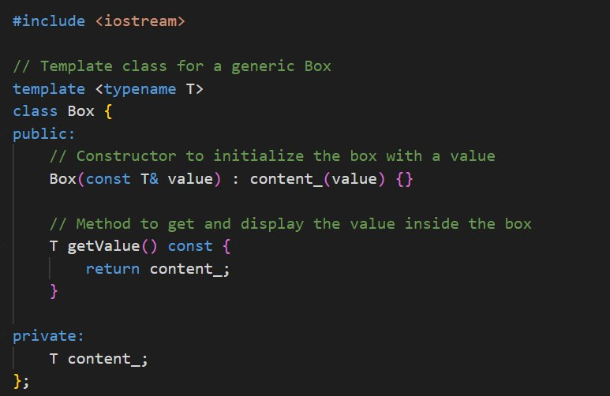
Template Class Example

Slide 43
